Slide 1
Flow Shop Scheduling

Slide 2
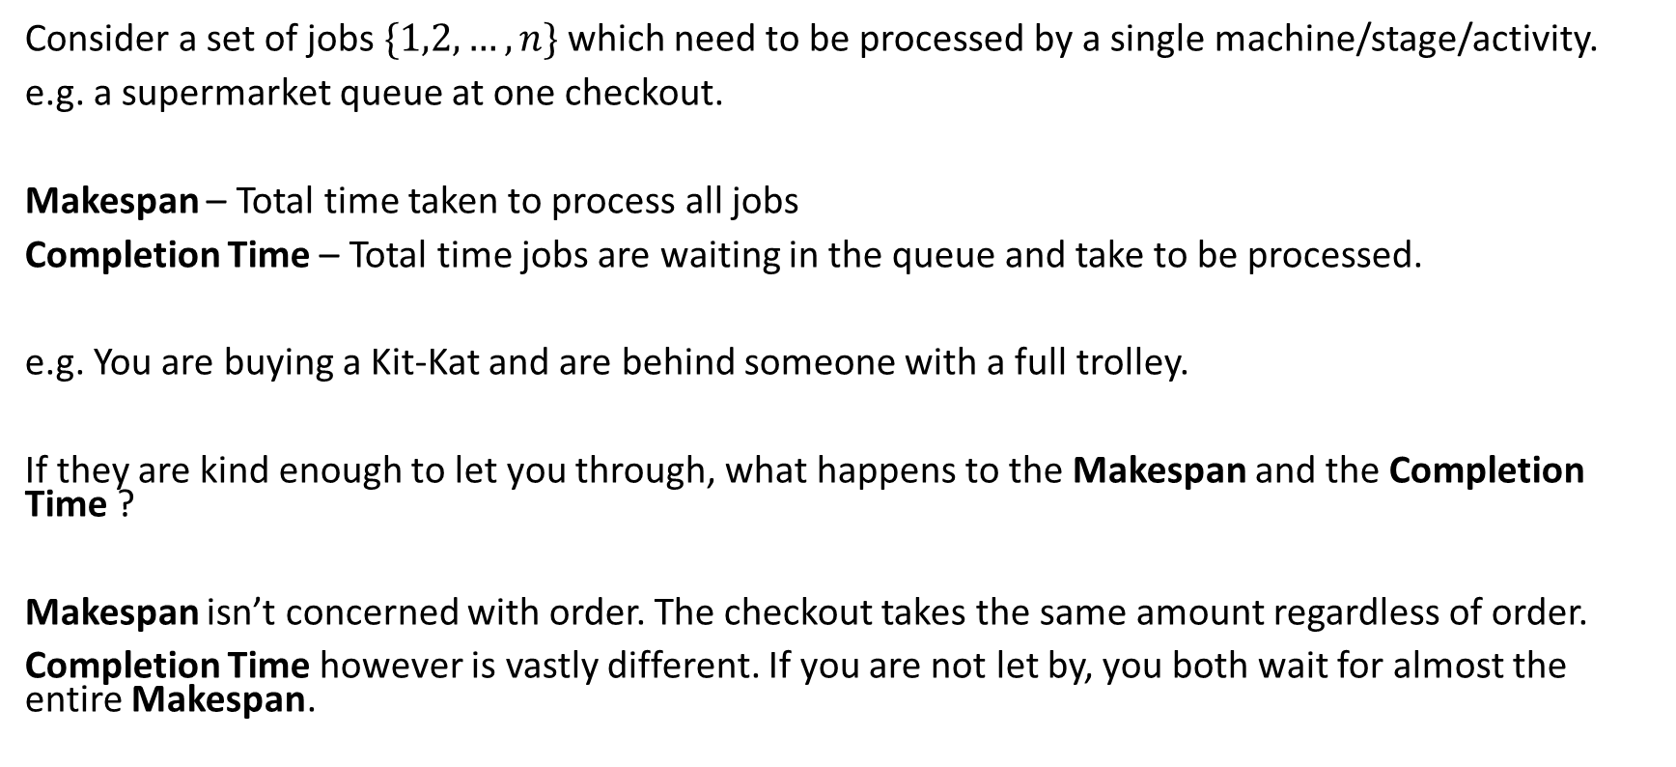
Scheduling - Single Stage
Consider a set of jobs $\{1,2,…,n\}$ which need to be processed by a single machine/stage/activity.
e.g. a supermarket queue at one checkout.
Makespan – Total time taken to process all jobs
Completion Time – Total time jobs are waiting in the queue and take to be processed.
e.g. You are buying a Kit-Kat and are behind someone with a full trolley.
If they are kind enough to let you through, what happens to the Makespan and the Completion Time ?
Makespan isn’t concerned with order. The checkout takes the same amount regardless of order.
Completion Time however is vastly different. If you are not let by, you both wait for almost the entire Makespan.

Slide 3


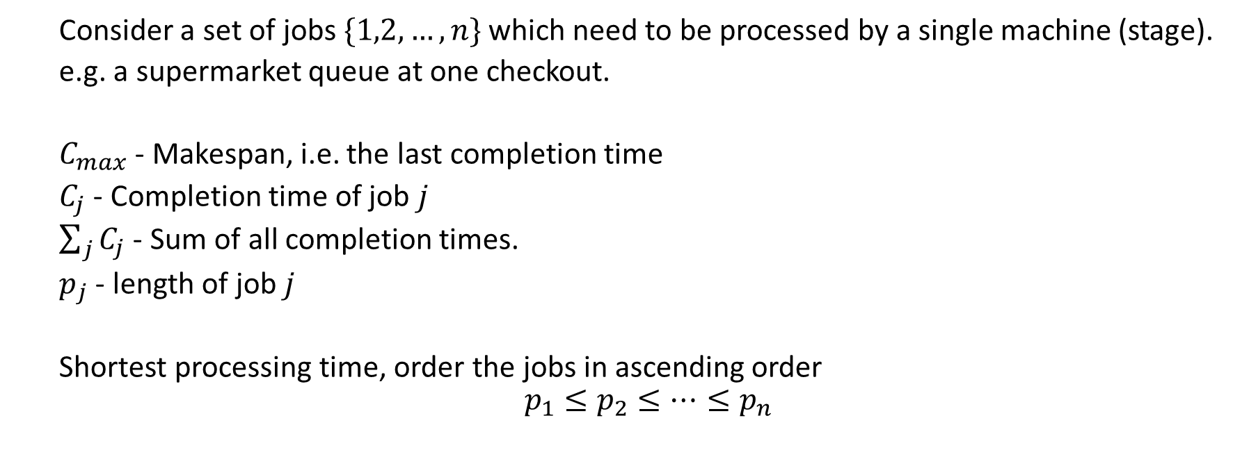






Shortest Processing Time
Consider a set of jobs $\{1,2,…,n\}$ which need to be processed by a single machine (stage).
e.g. a supermarket queue at one checkout.
$C_{max}$ - Makespan, i.e. the last completion time
$C_{j}$ - Completion time of job $j$
$\sum_{j}{C_{j}}$ - Sum of all completion times.
$p_{j}$ - length of job $j$
Shortest processing time, order the jobs in ascending order
$$p_{1}≤p_{2}≤…≤p_{n}$$
$C_{j}$
$C_{max}$
$$p_{1}$$
$$p_{2}$$
$$…$$
$$p_{j}$$
$$…$$
$$p_{n}$$

Slide 4
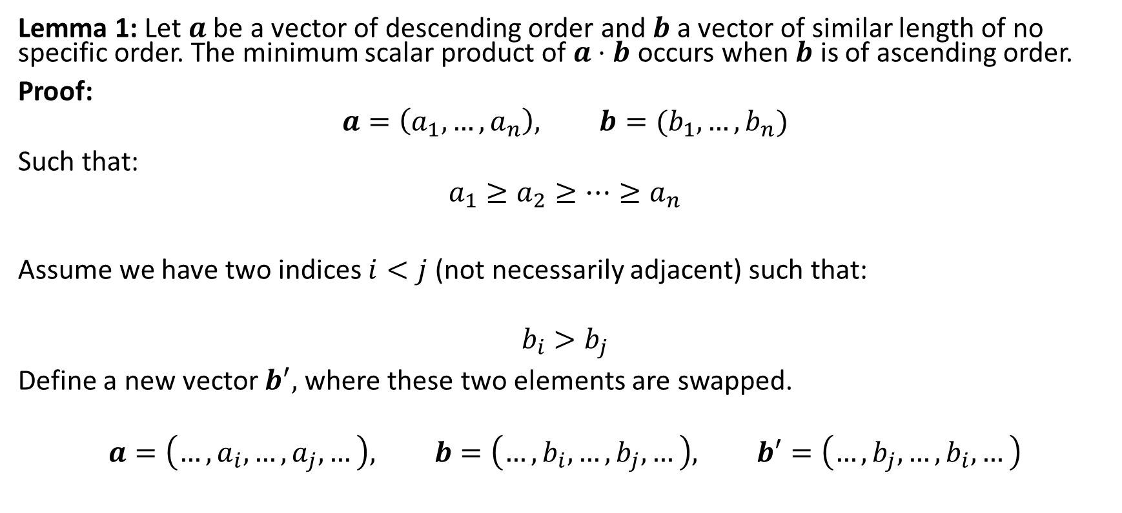
Shortest Processing Time
Lemma 1: Let $a$ be a vector of descending order and $b$ a vector of similar length of no specific order. The minimum scalar product of $a⋅b$ occurs when $b$ is of ascending order.
Proof:
$$a=\left(a_{1},…,a_{n}\right), b=(b_{1}, …,b_{n})$$
Such that:
$$a_{1}≥a_{2}≥…≥a_{n}$$
Assume we have two indices $i<j$ (not necessarily adjacent) such that:
$$b_{i}>b_{j}$$
Define a new vector $b^{′},$ where these two elements are swapped.
$$a=\left(…,a_{i}, …, a_{j},…\right), b=\left(…,b_{i}, …, b_{j},…\right), b′=\left(…,b_{j}, …, b_{i},…\right)$$

Slide 5
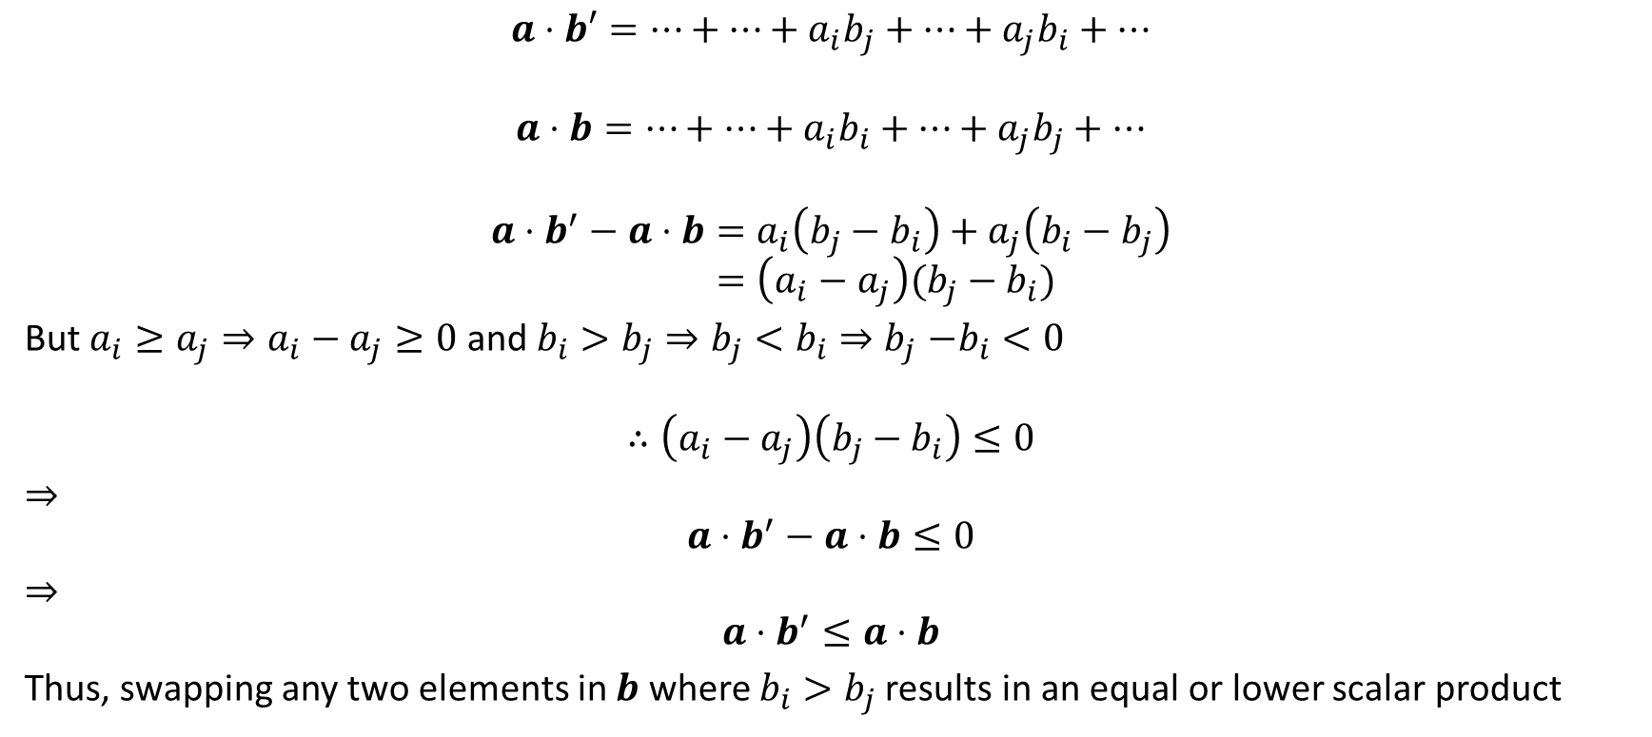
Shortest Processing Time
$$a⋅b′=…+…+a_{i}b_{j}+…+a_{j}b_{i}+…$$
$$a⋅b=…+…+a_{i}b_{i}+…+a_{j}b_{j}+…$$
$$a⋅b^{′}−a⋅b=a_{i}\left(b_{j}−b_{i}\right)+a_{j}\left(b_{i}−b_{j}\right) \\ =\left(a_{i}−a_{j}\right)(b_{j}−b_{i})$$
But $a_{i}≥a_{j}⇒a_{i}−a_{j}≥0$ and $b_{i}>b_{j}⇒b_{j}<b_{i}{⇒b}_{j}−b_{i}<0$
$$∴\left(a_{i}−a_{j}\right)\left(b_{j}−b_{i}\right)≤0$$
$⇒$
$$a⋅b^{′}−a⋅b≤0$$
$⇒$
$$a⋅b^{′}≤a⋅b$$
Thus, swapping any two elements in $b$ where $b_{i}>b_{j}$results in an equal or lower scalar product

Slide 6

Shortest Processing Time
Therefore, for any $b$ not in ascending order, there exists a swap which results in an equal or lower scalar product $a⋅b$.
Thus, the minimum is attained when $b$ is in ascending order. $∎$

Slide 7
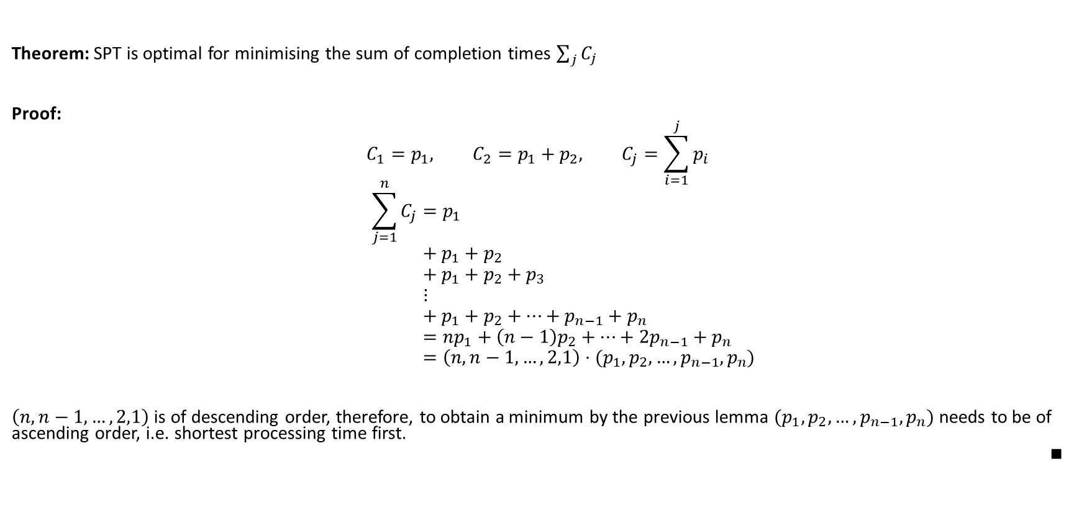
Shortest Processing Time
Theorem: SPT is optimal for minimising the sum of completion times $\sum_{j}{C_{j}}$
Proof:
$$C_{1}=p_{1}, C_{2}=p_{1}+p_{2}, C_{j}=\sum_{i=1}^{j}{p_{i}}$$
$$\sum_{j=1}^{n}{C_{j}}=p_{1} \\ + p_{1}+p_{2} \\ + p_{1}+p_{2}+p_{3} \\ ⋮ \\ + p_{1}+p_{2}+…+p_{n−1}+p_{n} \\ =np_{1}+\left(n−1\right)p_{2}+…+2p_{n−1}+p_{n} \\ =\left(n,n−1,…,2,1\right)⋅(p_{1},p_{2},…,p_{n−1},p_{n})$$
$\left(n,n−1,…,2,1\right)$ is of descending order, therefore, to obtain a minimum by the previous lemma $(p_{1},p_{2},…,p_{n−1},p_{n})$ needs to be of ascending order, i.e. shortest processing time first.
$$∎$$

Slide 8
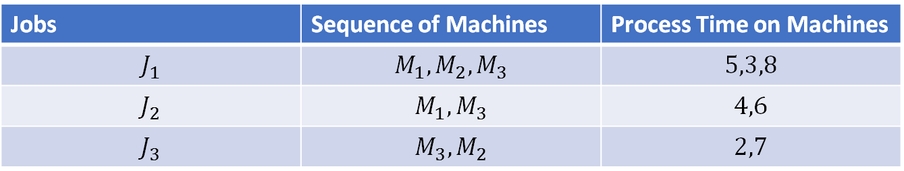
Job Shop Scheduling
This involves scheduling multiple jobs on multiple machines.
e.g.
This is known to a class of problems called NP
Thought to be impossible to solve in polynomial-time. i.e. as problem increases, the time to solve evolves quicker than a polynomial.
Look for a ‘good’ solution! Next Week!
Jobs | Sequence of Machines | Process Time on Machines
$$J_{1}$$ | $$M_{1},M_{2},M_{3}$$ | $$5,3,8$$
$$J_{2}$$ | $$M_{1}, M_{3}$$ | $$4,6$$
$$J_{3}$$ | $$M_{3},M_{2}$$ | $$2,7$$

Slide 9

Trivia Time…
The average human body contains how many pints of blood?
9
The Statue of Liberty was given to the US by which country?
France
What title is shared by a 1983 Lionel Richie song and a 2015 Adele song?
Hello

Slide 10
Flow Shop Scheduling
We will deal with a simpler set up than the general job shop scheduling problem.
Often a company will have multiple jobs (e.g. products) that go through multiple stages (machines) sequentially.
Each job may require a different amount of time at each stage.

Slide 11
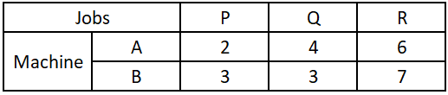
Example
Consider a 2 stage process in sequence.
A
B
Start Job
End Job
Job Processed at Stage 1
Job Processed at Stage 2
Each job requires different times at each stage.
e.g.

Slide 12
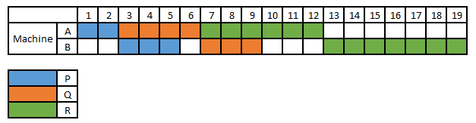
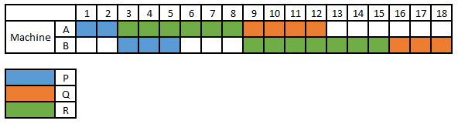
Example
Schedule jobs in order they appear. PQR
Is this optimal for Makespan? i.e. is everything completed as quickly as possible?
No PRQ

Slide 13
Makespan and Idle Time
Makespan is the total time required to completed all jobs
Idle Time is the time a stage (machine) is idle.
Stage A is idle for 6 units of time.
Stage B is idle for 2+3=5 units of time.

Slide 14

Optimality
Optimality is difficult to check!
How many possible permutations. No repetitions and order matters!
Q
R
$$3×2×1=6$$
OR
$$3!=6$$
For $n$ jobs there are $n!$ ways of scheduling.
e.g. $10$ jobs, $10!=3628800$
P
R
Q
P
R
Q
R
P
P
Q
R
Q
P

Slide 15
Johnson’s Rule
Minimises Makespan
Optimal solution for 2 stages (machines)
Optimal solution for 3 stages (machines) given additional conditions
  Not covering this…
Everything else is in NP
In general problems like these require clever guessing (heuristics)
It effectively schedules the jobs which are small for the first stage at the beginning, and those that are small for the second stage at the end.
https://www.rand.org/content/dam/rand/pubs/papers/2008/P402.pdf

Slide 16
Johnson’s Rule (Two stage)
Steps
  List the jobs
  Select the job with the shortest activity time, break ties arbitrarily
    If shortest is for first stage, schedule as early as possible
    Else if shortest is for second stage, schedule as late as possible
  Remove the job from list.
  Repeat 2 and 3 until no jobs are left to schedule

Slide 17
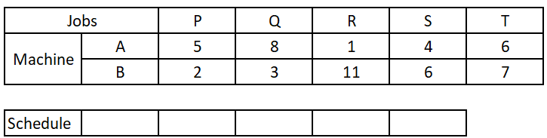
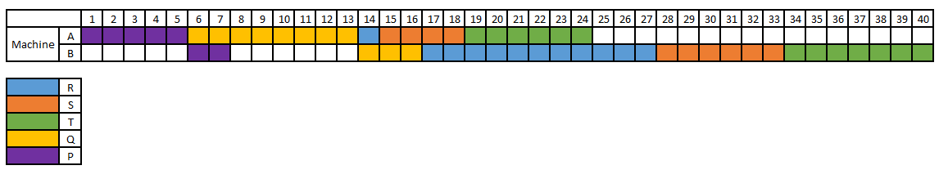
Example
Before applying Johnson’s Rule
Metric | Time
Makespan | 40
Idle Time of A | 16
Idle Time of B | 11
Total Idle Time | 27

Slide 18
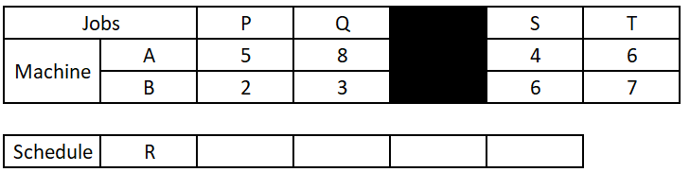
Example
  List the jobs
  Select the job with the shortest activity time.
    If shortest is for first activity, schedule as early as possible
    Else if shortest is for second activity, schedule as late as possible
  Remove the job from list.
  Repeat 2 and 3 until no jobs are left to schedule

Slide 19
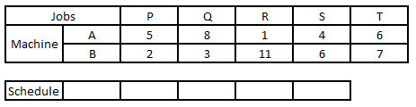
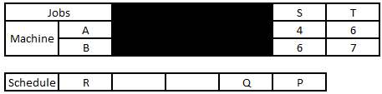
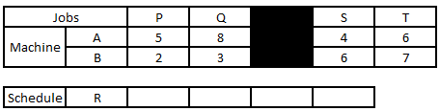
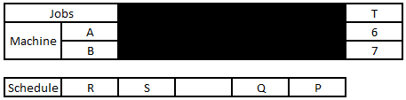
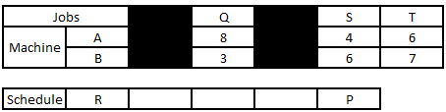
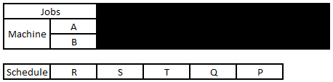
Example

Slide 20
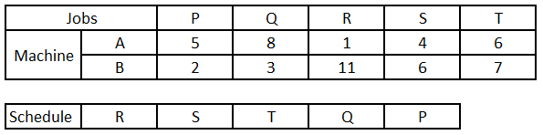
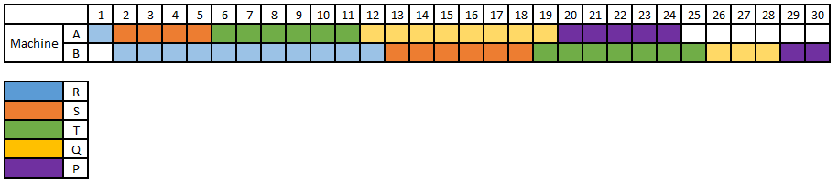
Example
After applying Johnson’s Rule
Solution | Makespan | Idle Time of A | Idle Time of B | Total Idle Time
Original order | 40 | 16 | 11 | 27
Johnson’s | 30 | 6 | 1 | 7

Slide 21
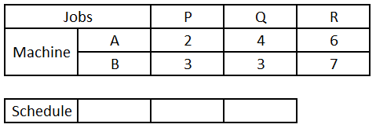
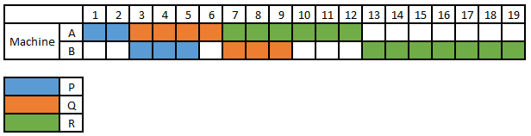
Example 2
Solution | Makespan | Idle Time of A | Idle Time of B | Total Idle Time
Original order | 19 | 7 | 6 | 13

Slide 22
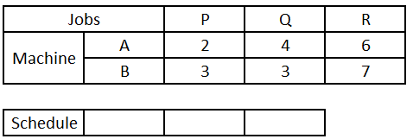
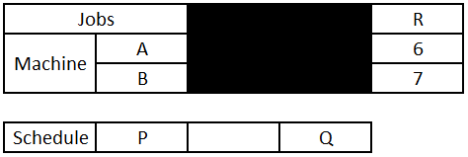
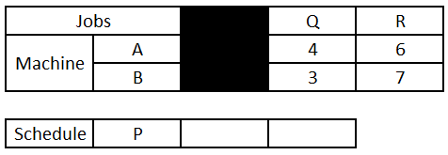
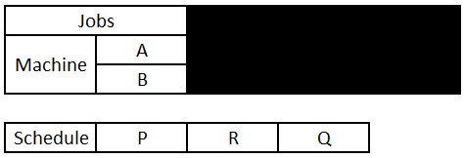
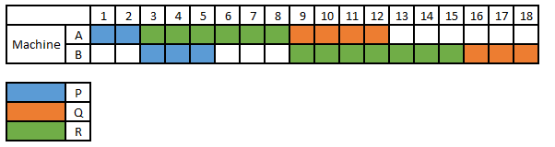
Example 2
Solution | Makespan | Idle Time of A | Idle Time of B | Total Idle Time
Original order | 19 | 7 | 6 | 13
Johnson’s | 18 | 6 | 5 | 11

Slide 23

Determining Makespan via Network
Jobs
P
R
Q
2
2
6
2+6=8
4
A
Machine
2
2+6=8
8+4=12
3
7
3
B
2+3=5
max(8,5)+7=15
max(12,15)+3=18

Slide 24
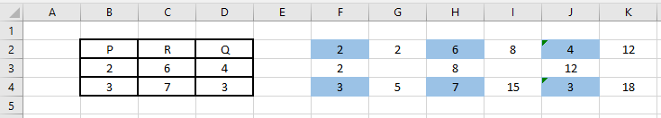
Easily Converted to Excel
Jobs
P
R
Q
2
2
6
2+6=8
4
A
Machine
2
2+6=8
8+4=12
B
3
7
3
2+3=5
max(8,5)+7=15
max(12,15)+3=18
=G2+H2
Activity times copied over
=F3+F4
=MAX(G4,H3)+ H4

Slide 25
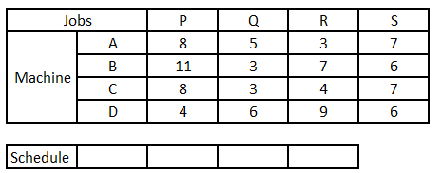
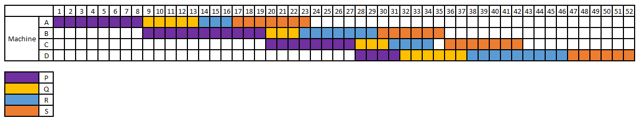
More Than 2 Machines
Solution | Makespan | Idle Time of A | Idle Time of B | Idle Time of C | Idle Time of D | Total Idle Time
Original order | 52 | 29 | 25 | 30 | 27 | 111

Slide 26
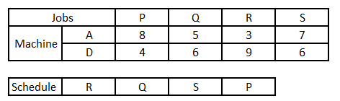
More Than 2 Machines
Johnson’s rule can be used to reduce the size of the search space.
Idea - reduce to a 2-stage problem. This is a heuristic!
  Only produces a good solution, not necessarily optimal!
  Often named the method/approach of Campbell Dudek and Smith
e.g. First and last stage considered
Makespan - 46

Slide 27
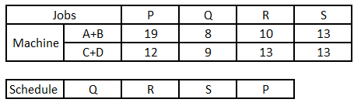
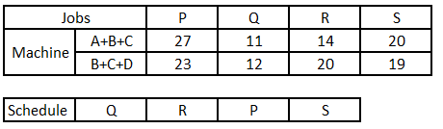
Other Possibilities
Aggregate the first two machines and last two machines
Makespan - 46
Aggregate the first three machines and last three machines
Makespan - 48

Slide 28
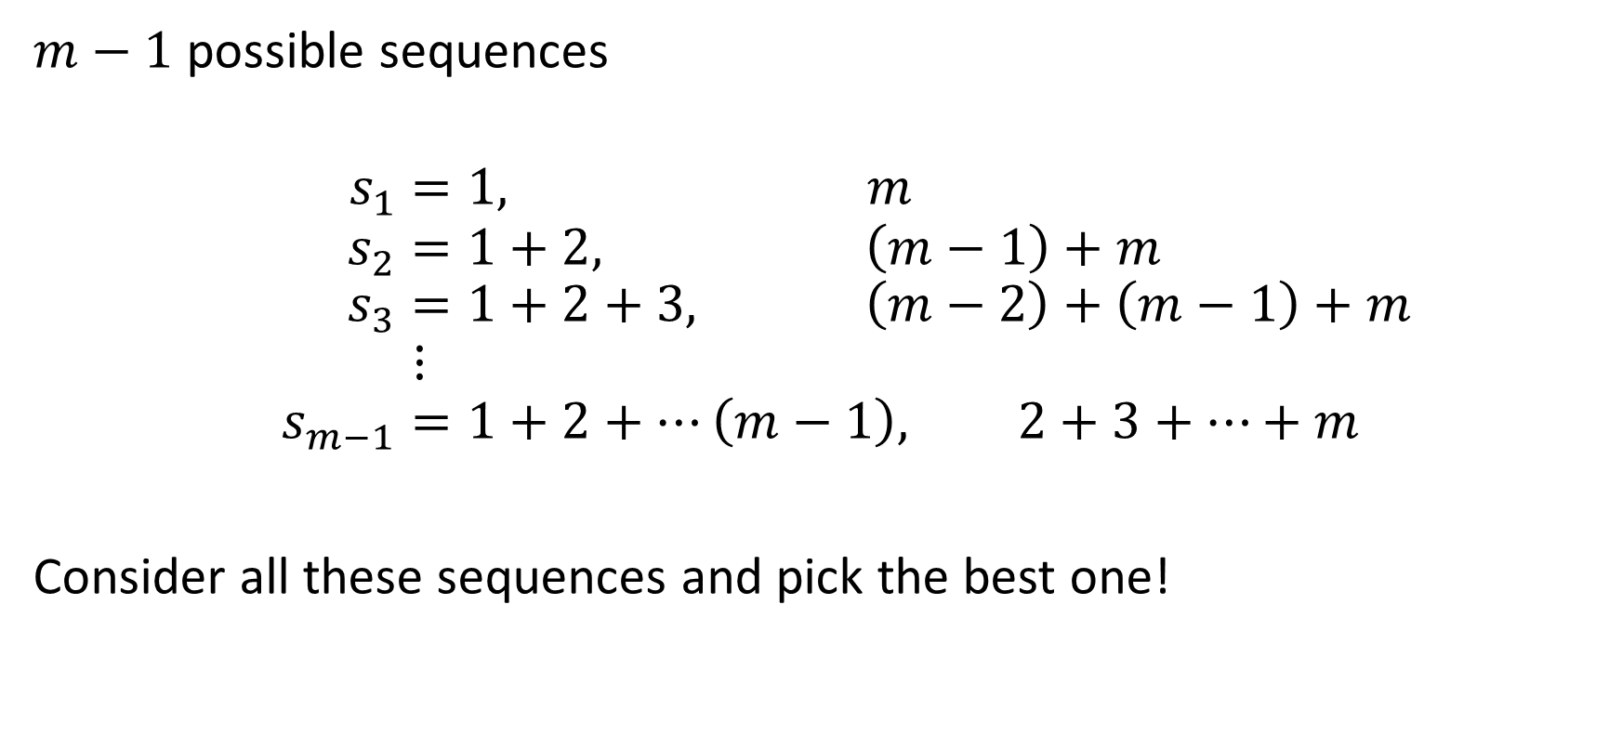

For $m$ machines
$m−1$ possible sequences
$$s_{1}=1, m \\ s_{2}=1+2, \left(m−1\right)+m \\ s_{3}=1+2+3, \left(m−2\right)+\left(m−1\right)+m \\ ⋮ \\ s_{m−1}=1+2+…\left(m−1\right), 2+3+…+m$$
Consider all these sequences and pick the best one!

